Slide 1




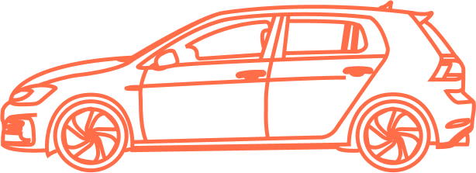

USER
RESEARCH PLAN
Ana Rita Gonçalves – 86377
Francisco Santos Silva – 82516
Henrique Carvalho – 84724
Miguel Coelho – 84614
Pedro Rodrigues – 83548
Tomás Costa - 83570

Slide 2



STAKEHOLDERS
Commuters who own a car and have available seats
Commuters who don’t own a car
370.000
cars get into Lisbon every day
(Expresso)
City Hall
Commuters who don’t own a smartphone

Slide 3
CONTEXT OF USE
[Passenger] Searching for a published route
[Driver] Announcing the route in the app

Slide 4
NEEDS AND EXPECTATIONS
EXPECTATIONS
NEEDS
Less Traffic
More parking spots
Lower transportation costs
Get to work on time
Reliable and secure transportation

Slide 5

USER RESEARCH
Questionnaire
Think Aloud
Contextual Inquiry

Slide 6

Mobility
QUESTIONNAIRE: AREAS OF INQUIRY
Carpooling
Application Interaction
Notes:
Our questionnaire is splited in three parts in the:
Mobility: In this phase we asked about the mobility habits and the influence of their transport means in users daily life, this way we can understand the dificulties and how to make the users life easier
Carpooling: We want to understand the users opinion, if they already used or heard about carpooling, in case it is unknown what they think about the concept. Thus, we can get a sense of what people think of the idea and the concerns we should relieve
Application Interaction: The last step have three questions directed to the most important usability factors of an app and how their prefer to pay to have access to the service. This help us to structure our business strategy

Slide 7
USER GOALS
THINK ALOUD
PARTICIPANTS
OBSERVER TASKS
1 User
1 Driver
1 Observer
Use a carpooling application to catch a ride between IST’s campus
Instruct user
Supply resources
Take notes of verbalized thoughts
Question user

Slide 8
USER GOALS
CONTEXTUAL INQUIRY
PARTICIPANTS
OBSERVER TASKS
3 Users
1 Driver
1 Observer
Carpool from from Instituto Superior Técnico’s Alameda campus to Almada.
Instruct user
Observe and take notes of user's interaction
Inquiry users

Slide 9
Thanks!
Any Questions?

